Slide 1
Economics
Week #5

Slide 2
Topics of Week #5
Price Controls
Binding / Non-binding Price Ceiling*
Binding / Non-binding Price Floor*
Labor Market
Consumer Surplus* / Willingness to Pay
Producer Surplus* / Willingness to Sell
Taxation
Deadweight Loss*
"*" Indicates the most important topics.
Mateer and Coppock: Chapter #5 and #6

Slide 3
What Are Price Controls?
Price controls
Attempt to set, or manipulate, prices through government involvement in the market.
Meant to ease perceived burdens on the population.
Price ceiling
Legally established maximum price for a good or service.
Price floor
Legally established minimum price for a good or service.
Throughout history, price controls
Disrupt the normal functions of the market.
Prevent the market from clearing.
Notes:
In most cases, and certainly in the United States, price controls are enacted to ease perceived burdens on the population. For example, when President Richard Nixon imposed price controls in 1971, he was trying to protect U.S. citizens from the threat of runaway inflation. To accomplish this objective, he imposed a 90-day wage and price freeze. The price freeze was greeted with cheers from consumers who had grown weary of rapidly escalating prices and believed that they were being gouged by firms.
Price ceilings are legally established maximum prices for goods or services.
Price floors are legally established minimum prices for goods or services.
For example, a number of cities have rent control policies, a price ceiling.
The minimum wage law is an example of a price floor.

Slide 4
Non-binding Price Ceiling
Notes:
In this example, the price ceiling is set above the market price. Since market prices are set by the intersection of supply and demand, as long as the equilibrium price is below the price ceiling, the price ceiling is non-binding.
Not all price ceilings are effective. When this is the case, the price ceiling is said to be non-binding. The figure shows a price ceiling of $2 a loaf in a market where $2 is above the equilibrium price. All prices at, or below, $2 (the green-shaded region) are legal. Prices above the price ceiling (the red-shaded area) are illegal. But since the market equilibrium, at point E, occurs in the green region, the price ceiling does not affect the functioning of the market and is, therefore, non-binding. Price is regulated by supply and demand as long as the equilibrium remains below the price ceiling.

Slide 5
Binding Price Ceiling
Notes:
When a price ceiling is below the market price, it creates a binding constraint that prevents supply and demand from clearing the market. In the figure, the price ceiling for bread is set at $0.50 a loaf. Since $0.50 is well below the equilibrium price of $1.00, this creates a binding price ceiling. Notice that at a price of $0.50, Q_{D} is greater than Q_{S}. Because the quantity demanded is greater than the quantity supplied, a shortage exists. Shortages typically cause prices to rise, but under a price ceiling only the prices in the green-shaded area are legal. Therefore, the market cannot reach the equilibrium point E at $1.00 because it is located above the price ceiling in the red area. Since the price mechanism is no longer able to legally ration the good, a black market for bread arises.
The black market price is also set by supply and demand. But notice in the figure that the supply curve, created by the price ceiling, is vertical. Since prices above $0.50 are illegal, sellers are unwilling to produce more than Q_{S}. Once the price ceiling is in place, producers cannot legally charge high prices so the incentive to produce along the original supply curve vanishes. Since a shortage still exists, the intersection of the vertical supply curve and the demand curve at point E_{b} establishes the black market price, P_{b} at $2.00. The black-market price eliminates the shortage caused by the price ceiling. However, the price ceiling has created two unintended consequences: a smaller supply of bread is produced (Q_{S} is less than Q_{E}) and a higher price exists for those who are forced to purchase bread on the black market.

Slide 6
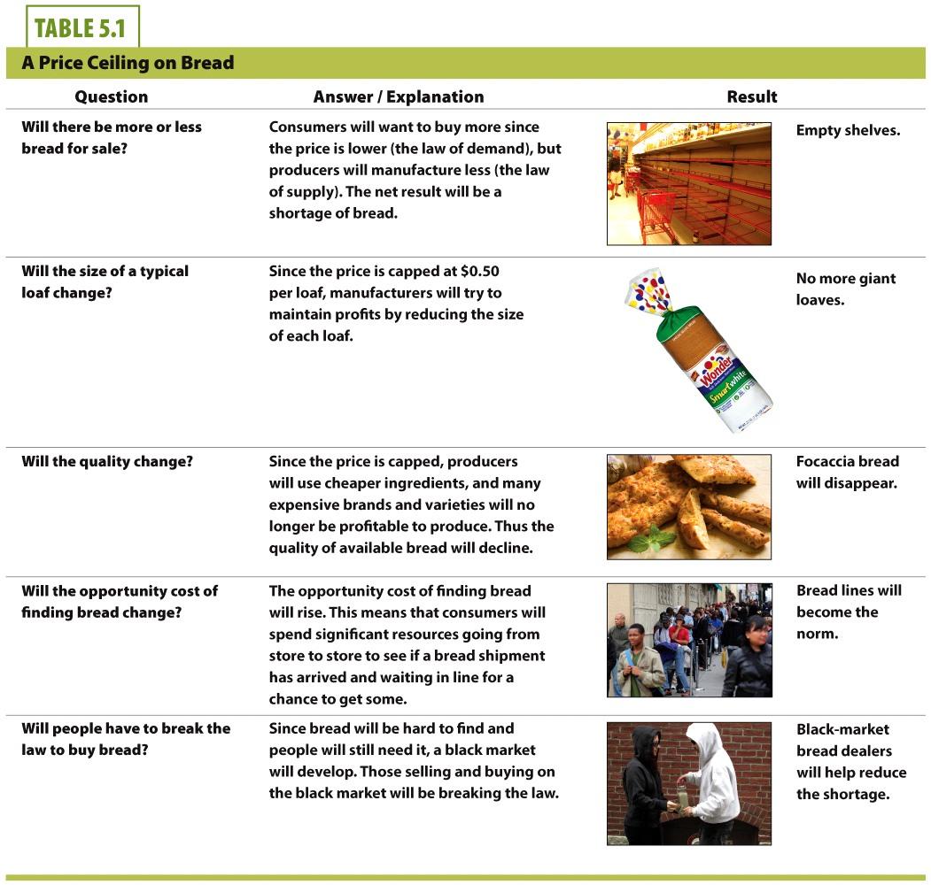

Slide 7
Price Ceiling in the Long Run
Notes:
This figure shows the result of a price ceiling that remains in place over a long period of time. Here, the supply curve is more elastic than its short-run counterpart in the previous figure. The supply curve is flatter because producers are able to respond by producing less bread in the long run. As a result, Q_{S} is quite small. In the long run, producers will convert the equipment used to make price-controlled breads into equipment used to make similar products that are not price controlled (like bagels and rolls) where they can earn a reasonable return on their investments.
Likewise, the demand curve is more elastic in the long run. For instance, as we remove short-term constraints on the consumer, more people will attempt to take advantage of the low price ceiling by adapting their eating habits and changing recipes to use more bread. A flatter demand curve means that consumers are more flexible. As a result, Q_{D} expands and becomes much larger than it was in the previous figure.
Increased elasticity on the part of both producers and consumers creates the shortage shown in Figure 5.3 larger in the long run than it was in the short run. As a result, products subject to price ceilings become progressively harder to find in the long run. More importantly, the unintended consequences we observed in the short run are magnified.

Slide 8

Case Study: Price Ceilings
Rent control
Price ceiling on apartments or housing
Goal:
Help low-income renters find affordable places to live
Notes:
Often, the government intervenes in the market with the goal of helping a specific group. However, we usually see unintended consequences caused by intervention.

Slide 9
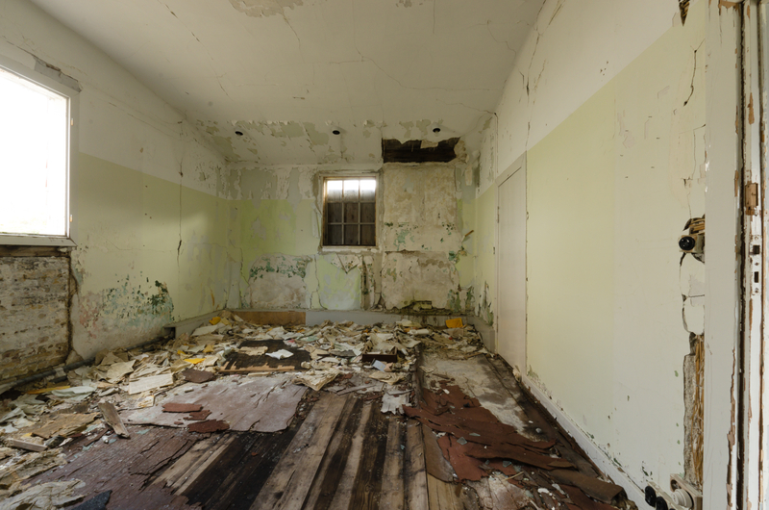
Rent Control
Unintended consequences of rent control:
Shortages (Q_{d} > Q_{s})
Decreases in long-term investment in the building of new units
Reduction in quality of apartments
Black markets with higher prices
Landlords "nickel and diming" tenants with fees to increase revenues
Notes:
Shortages are an obvious result. When the price is kept artificially below equilibrium, the Q_{d} is greater and the Q_{s} is smaller. Q_{d} > Q_{s} is the definition of shortage.
However, long-term shortages may be even worse. An investor looking to invest in a project may decide to build an apartment complex if he can expect a return of $1,000 per unit per month. However, with rent control, the return on the apartments may only be $500 per unit per month. The investor decides not to build the apartments. This exacerbates the shortage in the long run.
Because of rent controls, landlords cannot maximize their profits. They have a diminished incentive to maintain their properties, which become run down. Mumbai, India, provides a chilling example of what can happen when rent controls are applied over an extended period of time. In Mumbai, dilapidated buildings fall down on a regular basis during the monsoon season, often with tragic consequences. Rent-control policies have led to the decay of many apartment buildings and, contrary to the intent of the legislation, fewer housing choices for the poor.
The real life history of New York City provides the explanation. A rent-control program began in 1943 in the midst of World War II when the federal government established the Emergency Price Control Act. The act was designed to keep inflation in check during the war when the supply of many essential commodities was under enormous pressure due to fluctuations in the supply and demand of key resources. When the war ended in 1945 and the soldiers started to return, they found a city with rental prices frozen in 1943 dollars. Shortly after the war ended, the federal government discontinued price controls but the state of New York decided to continue rent control.
Today there are approximately one million rent-controlled units available in New York City. Rent controls limit the price a landlord can charge a tenant for rent. They also require that the landlord provide certain basic services, but not surprisingly, landlords limit the maintenance that they put into rent-controlled properties. They are required to maintain their properties, but that does not mean that those properties are freshly painted, have new carpets, or the latest amenities.
The portmanteau "slumlord" comes from the words "slum" and "landlord." It describes a landlord who does not maintain the property.
With black markets and bribes to gain access to rent-controlled units, low-income people are often kept out due to the inability to pay a high entry fee to gain access to the unit.
Landlords may also charge key money, high deposits, furniture rental fees, and other fees to make more revenues.

Slide 10
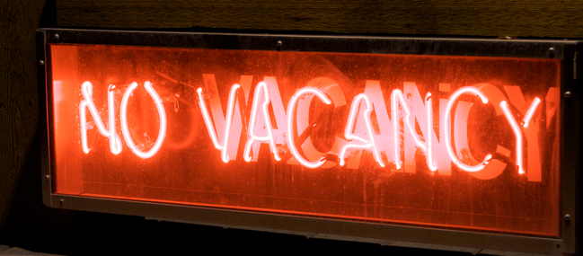
Rent Control
Unintended consequences of rent control
"Housing gridlock"
Units are actually harder to find.
Policy often ends up hurting the very people it was supposed to help.
Notes:
Housing gridlock means that no one is moving, so no new units open up. People will be afraid to move out of a rent-controlled unit since they may not be able to find low prices again.
Once the rent-controlled unit is vacated, the property is generally no longer subject to rent control. But many rent-controlled apartments are passed from one generation to the next in order to remain in the program. Rent-control units are already occupied and those who live in them are not likely to give them up. New York City is a prime example of a city where an acute shortage of affordable housing exists. Despite the shortage, rent control does appear to have benefited the many thousands of renters who are lucky enough (question: Is luck the best way to allocate resources?) to live in rent-controlled properties. Because these residents pay well below market price, they often have money leftover for other uses, including vacation housing. Since most of the rent-control apartments are passed from generation to generation, the program no longer remotely serves its original purpose—to help low-income households. The law makes it illegal to occupy a rent-stabilized property if it is not your primary residence, but this does not preclude owning weekend and vacation properties. Clearly, the law was never intended to subsidize fancy vacation homes, but that's what it does!
The attempt to make housing more affordable in the city has, ironically made housing harder to obtain, encouraged the building of upscale properties, as opposed to low-income units, and created a set of behaviors among landlords that is inconsistent with the ideals of justice and affordability that rent control was designed to address.

Slide 11
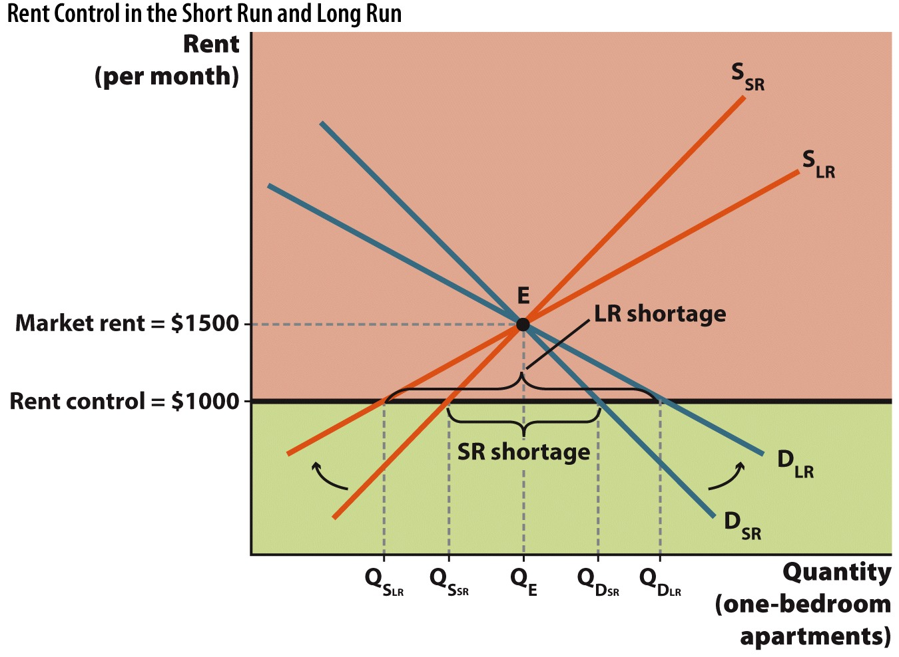
Rent Control in the Short Run and Long Run
Notes:
The attempt to make housing more affordable in the city has, ironically, made housing harder to obtain, encouraged the building of upscale properties, as opposed to low-income units, and created a set of behaviors among landlords that is inconsistent with the ideals of justice and affordability that rent control was designed to address.
As with any price ceiling, rent control causes a shortage to develop. Because rent-controlled apartments are vacated slowly, the supply of units contracts in the long run, which causes the supply curve to become more elastic. Demand also becomes more elastic in the long run, causing the quantity demanded to rise. The combination of fewer units available to rent and more consumers looking to find rent-controlled units leads to a larger shortage in the long run.

Slide 12
Rent Control and the Rich
Rent control and the rich
Massachusetts decided to end rent control in part because only 6% of people in rent-controlled units were poor.
Actresses Mia Farrow and Faye Dunaway lived in rent-controlled units for years.
Ask: Best allocation of resources?
Notes:
"Beyond the Book" Slide
When rich people live in rent-controlled units, we have to ask if it really is the intended (and best) allocation of that resource.
Websites
Top bullet:
http://www.spoa.com/pages/03rent-control.html
http://www.tenant.net/Alerts/Guide/press/nypress/tucker.html
Bottom bullet:
http://www.cato.org/pubs/pas/pa-274.html
From the cato.org site:
There can be no doubt that rent control creates housing shortages. For almost 20 years, national vacancy rates have been at or above 7 %, a figure generally considered normal. Cities such as Dallas, Houston, and Phoenix, where development is welcomed, have often had vacancy rates above 15 percent. In these areas of the country, there usually is a surplus of housing rather than a shortage. Landlords commonly advertise "move-in specials," where rent is reduced for the first month or even where they pay moving expenses.
In rent-controlled cities, on the other hand, vacancy rates have been uniformly below normal. New York City has not had a vacancy rate above 5% since World War II. (The state's rent-control law, supposedly temporary, would automatically expire if it did.) Before giving up rent control, Boston's vacancy rate was below 4%. (There are no figures as of yet on the rate since rent control ended.) In rent-controlled San Francisco, the vacancy rate is generally around 2%, and in San Jose the rate is 1%, the nation's lowest. Meanwhile, comparable non-rent-controlled cities, such as Chicago, Philadelphia, San Diego, and Seattle, have normal vacancy rates at or above 7%.
Rent-controlled cities absorb these shortages in a variety of ways. Higher rates of homelessness are a manifestation of rent control. Another is the traditional difficulty individuals have in finding a new apartment in these cities. An article in New York Magazine entitled, "Finding an Apartment (Seriously)," recommended such techniques as "joining a church or synagogue" as a useful technique in meeting people who might provide good leads on an apartment. Young people who migrate to New York or San Francisco usually must settle for paying $600 a month to share a two-bedroom apartment with several other people or commuting from a nearby city. Crowding is a manifestation of rent control.

Slide 13
Price Floors
Recall that a price floor is
A minimum legal price
Who do you think lobbies for price floors?
Producers of the product

Slide 14
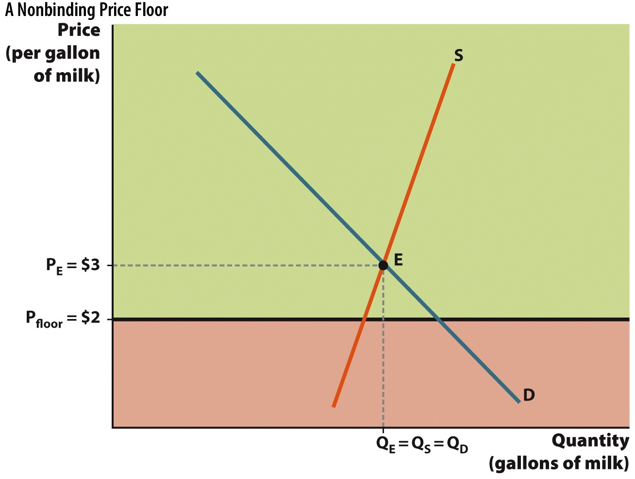
Non-binding Price Floor
Notes:
The price floor is below the equilibrium price so the price floor is non-binding. Since the actual market price is above the legally established minimum price, the price floor does not prevent the market from reaching point e. Consequently, the price floor has no impact on the functioning of the market. Price is regulated by supply and demand as long as the equilibrium remains above the price floor.

Slide 15
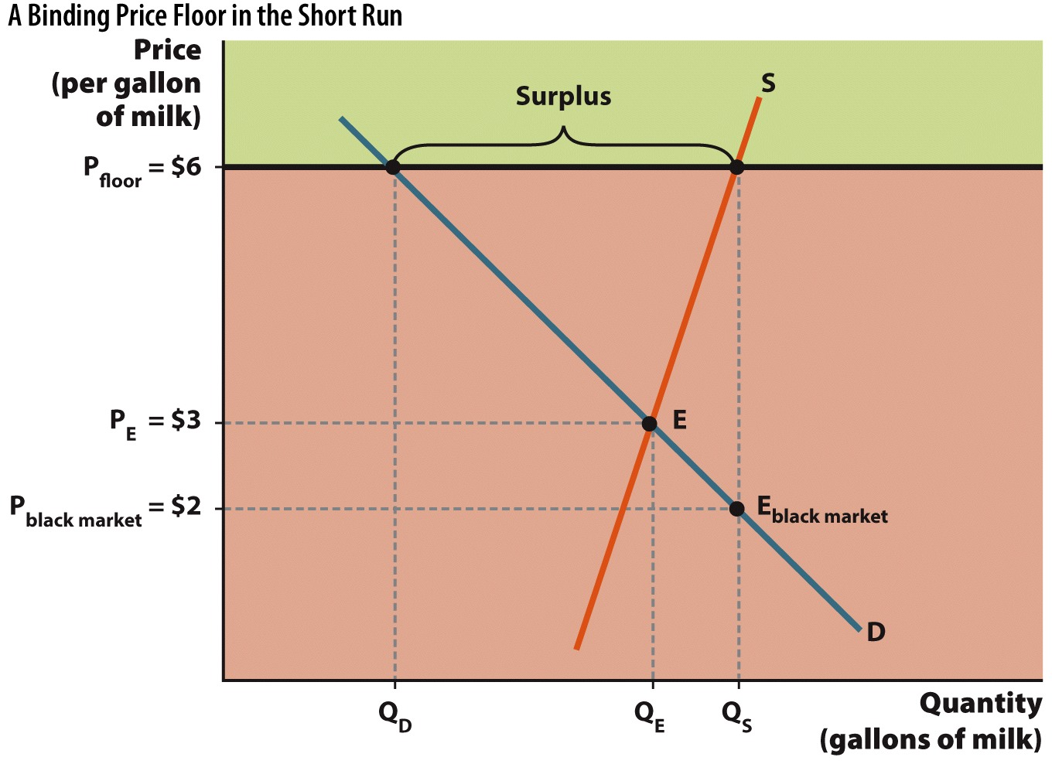
Binding Price Floor
Notes:
A binding price floor creates a surplus. This has two unintended consequences: a smaller demand than the equilibrium quantity (Q_{D} < Q_{E}), and a lower black-market price to eliminate the glut of the product.

Slide 16
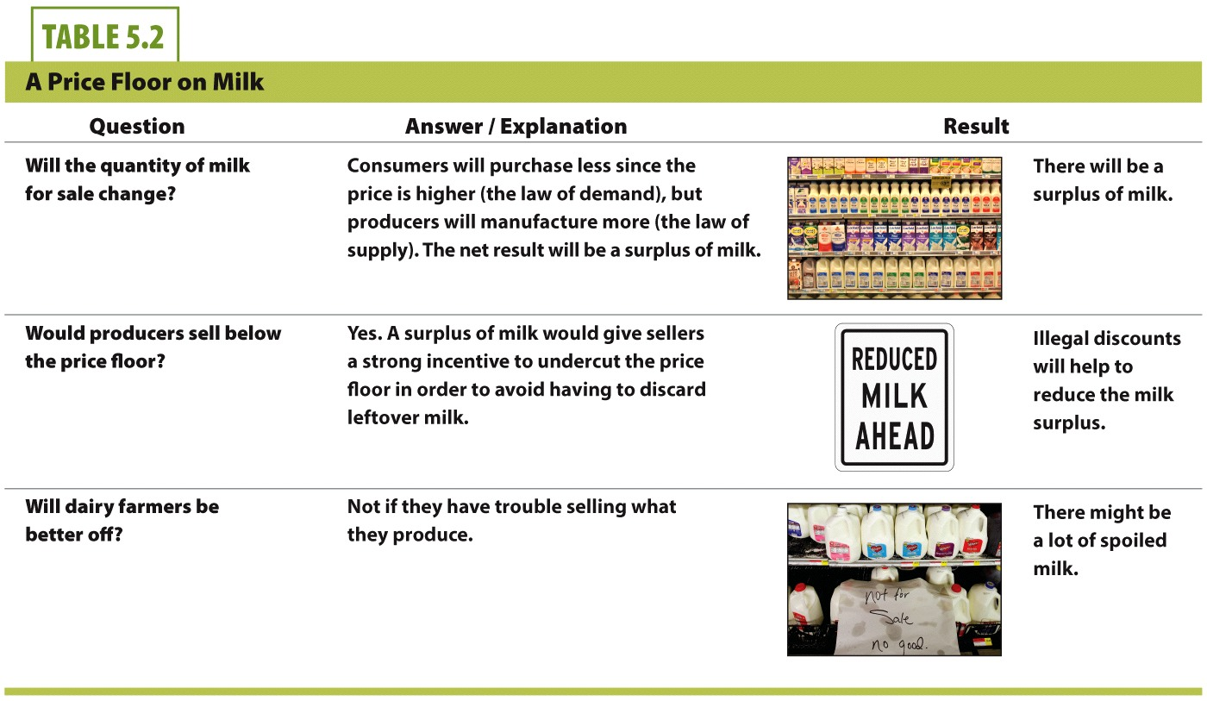

Slide 17
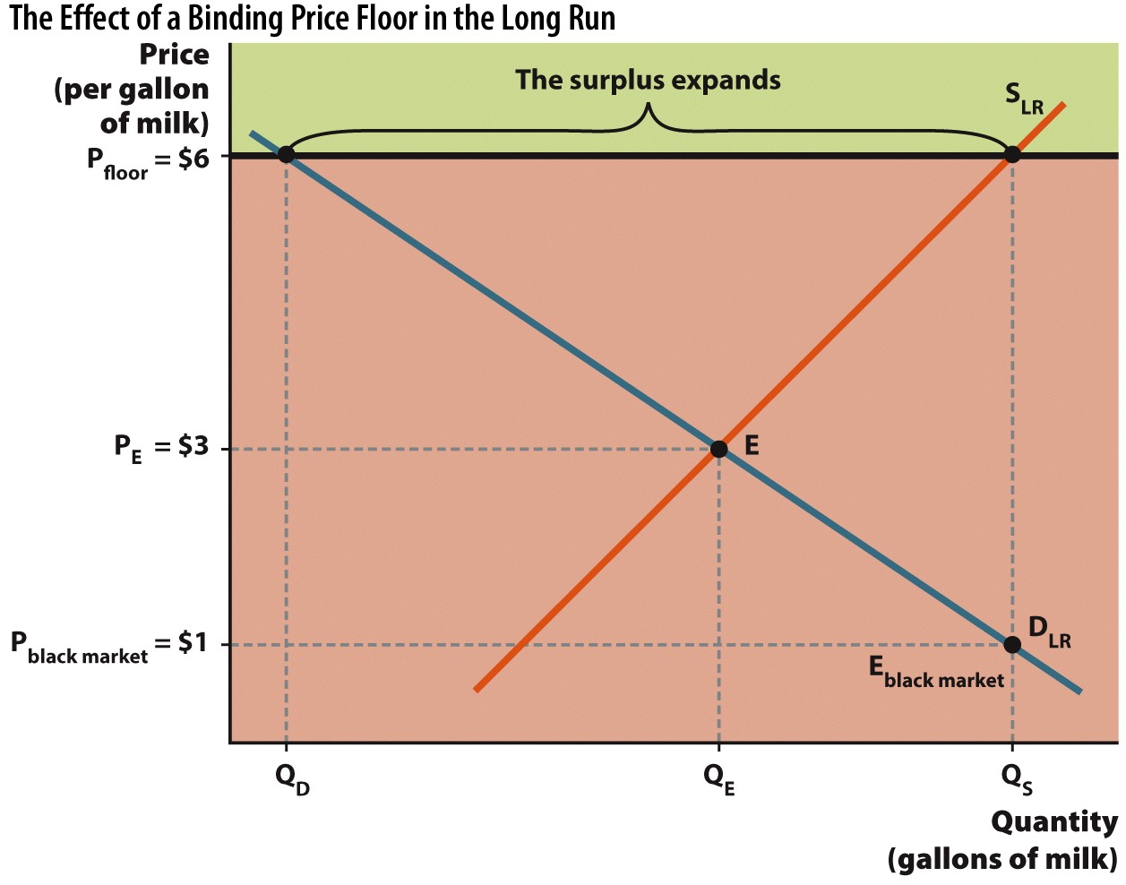
Price Floor in the Long Run
Notes:
When a price floor is left in place over time, supply and demand each become more elastic. This leads to a larger surplus (Q_{S} > Q_{D}) in the long run. Since sellers are unable to sell all that they produce at $6 per gallon, a black market develops in order to eliminate the glut of milk.

Slide 18
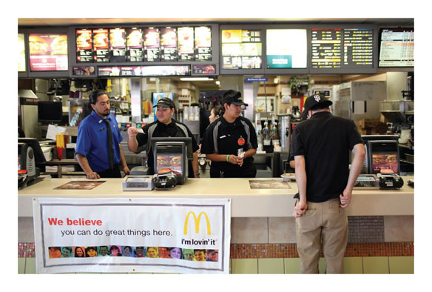
Case Study: Minimum Wage
Minimum wage
The lowest hourly wage rate that firms may legally pay their workers; it functions as a price floor.
Rationale for minimum wage:
Provide a "living wage."
Help the working poor who are often unskilled.

Slide 19
Labor Markets
In the supply and demand framework for goods and services:
Consumers (all of you) are the demanders of goods.
Firms (the businesses) are the suppliers (producers) of the goods.
Notes:
This is a bit of a review from the supply and demand chapter. The point is to make a comparison to a labor market.

Slide 20
Labor Markets
In the supply and demand framework for labor:
Consumers (all of you) are the suppliers of labor.
Firms (the businesses) are the demanders of labor.
The axes on a graph of a labor market
Wage (W) is the vertical axis. This is the price of labor.
Labor (L) is the horizontal axis. This is the number of workers.
Notes:
The firm purchases the labor that you are willing to supply at a given wage.

Slide 21
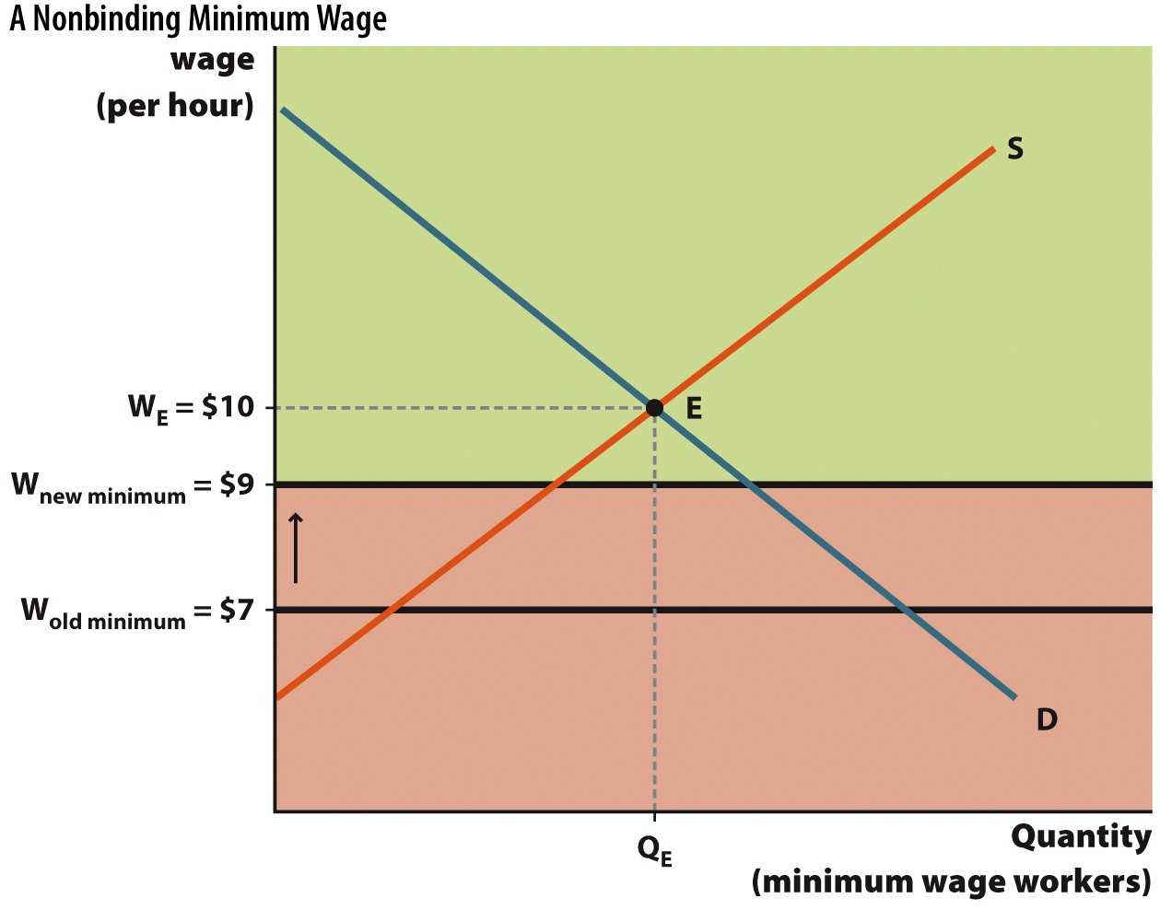
Non-binding Minimum Wage
Notes:
The minimum wage is often non-binding, or below the market wage.
Consider two non-binding minimum wage rates ($7 and $9); $7 an hour is far below the equilibrium wage of $10 so supply and demand will determine the wage. Suppose that politicians decide to raise the minimum wage to $9. The new minimum wage of $9 remains below the market wage so there is no impact on the labor market for workers who are willing to accept the minimum wage. Therefore, an increase in the minimum wage from $7 to $9 an hour will not create unemployment. Unemployment only occurs when the minimum wage rises above $10.

Slide 22
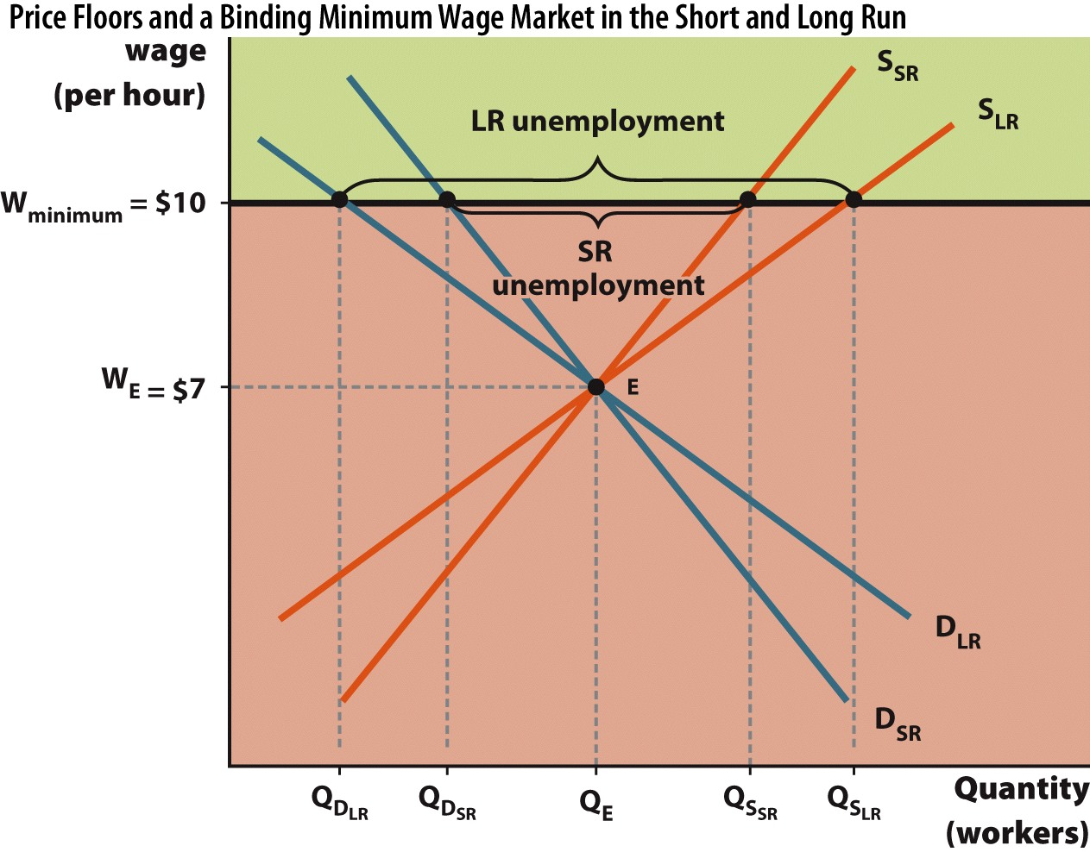
Minimum Wage in the Short Run and Long Run
Notes:
FIGURE 5.9 Price Floors and a Binding Minimum Wage Market in the Short and Long Run
A binding minimum wage is a price floor above the current equilibrium wage, WE. At $10 per hour, the number of workers willing to supply their labor (SSR) is greater than the demand for workers (DSR). The result is a surplus of workers (which we recognize as unemployment). Since the supply of workers and demand for workers both become more elastic in the long run, unemployment expands (S_{LR} > D_{LR}).
A binding minimum wage results in unemployment in the short run; since Q_{S(SR)} > Q_{D(SR)}, minimum wage workers can be skilled or unskilled and experienced or not. The common thread is that these workers, for a variety of reasons, lack better prospects. A minimum wage worker might be a high school student looking for a first job, a senior citizen supplementing retirement income, or an unemployed worker looking to help makes ends meet between higher-paying jobs.
Since the market equilibrium wage is below the minimum wage, supply and demand cannot eliminate the surplus of workers. The minimum wage prevents the market from reaching W_{e} at E because only the wages in the green-shaded area are legal. Any wages below the minimum wage—$10 in this example—are illegal. The demand for labor is a function of its cost. Because the minimum wage raises the cost of hiring workers, a higher minimum wage will lower the quantity of labor demanded.

Slide 23
Minimum Wage
The unintended consequence of a binding minimum wage is unemployment. Caused by:
Decrease in quantity demanded for labor.
Increase in quantity supplied of labor.
Firms replacing low-skilled jobs with capital, if possible.
Firm relocation to countries without wage laws.
Shortening hours for workers.
Notes:
Proponents of minimum wage are aware of the problems caused by minimum wage. That's why they also advocate for additional training and education of low-skilled workers.

Slide 24
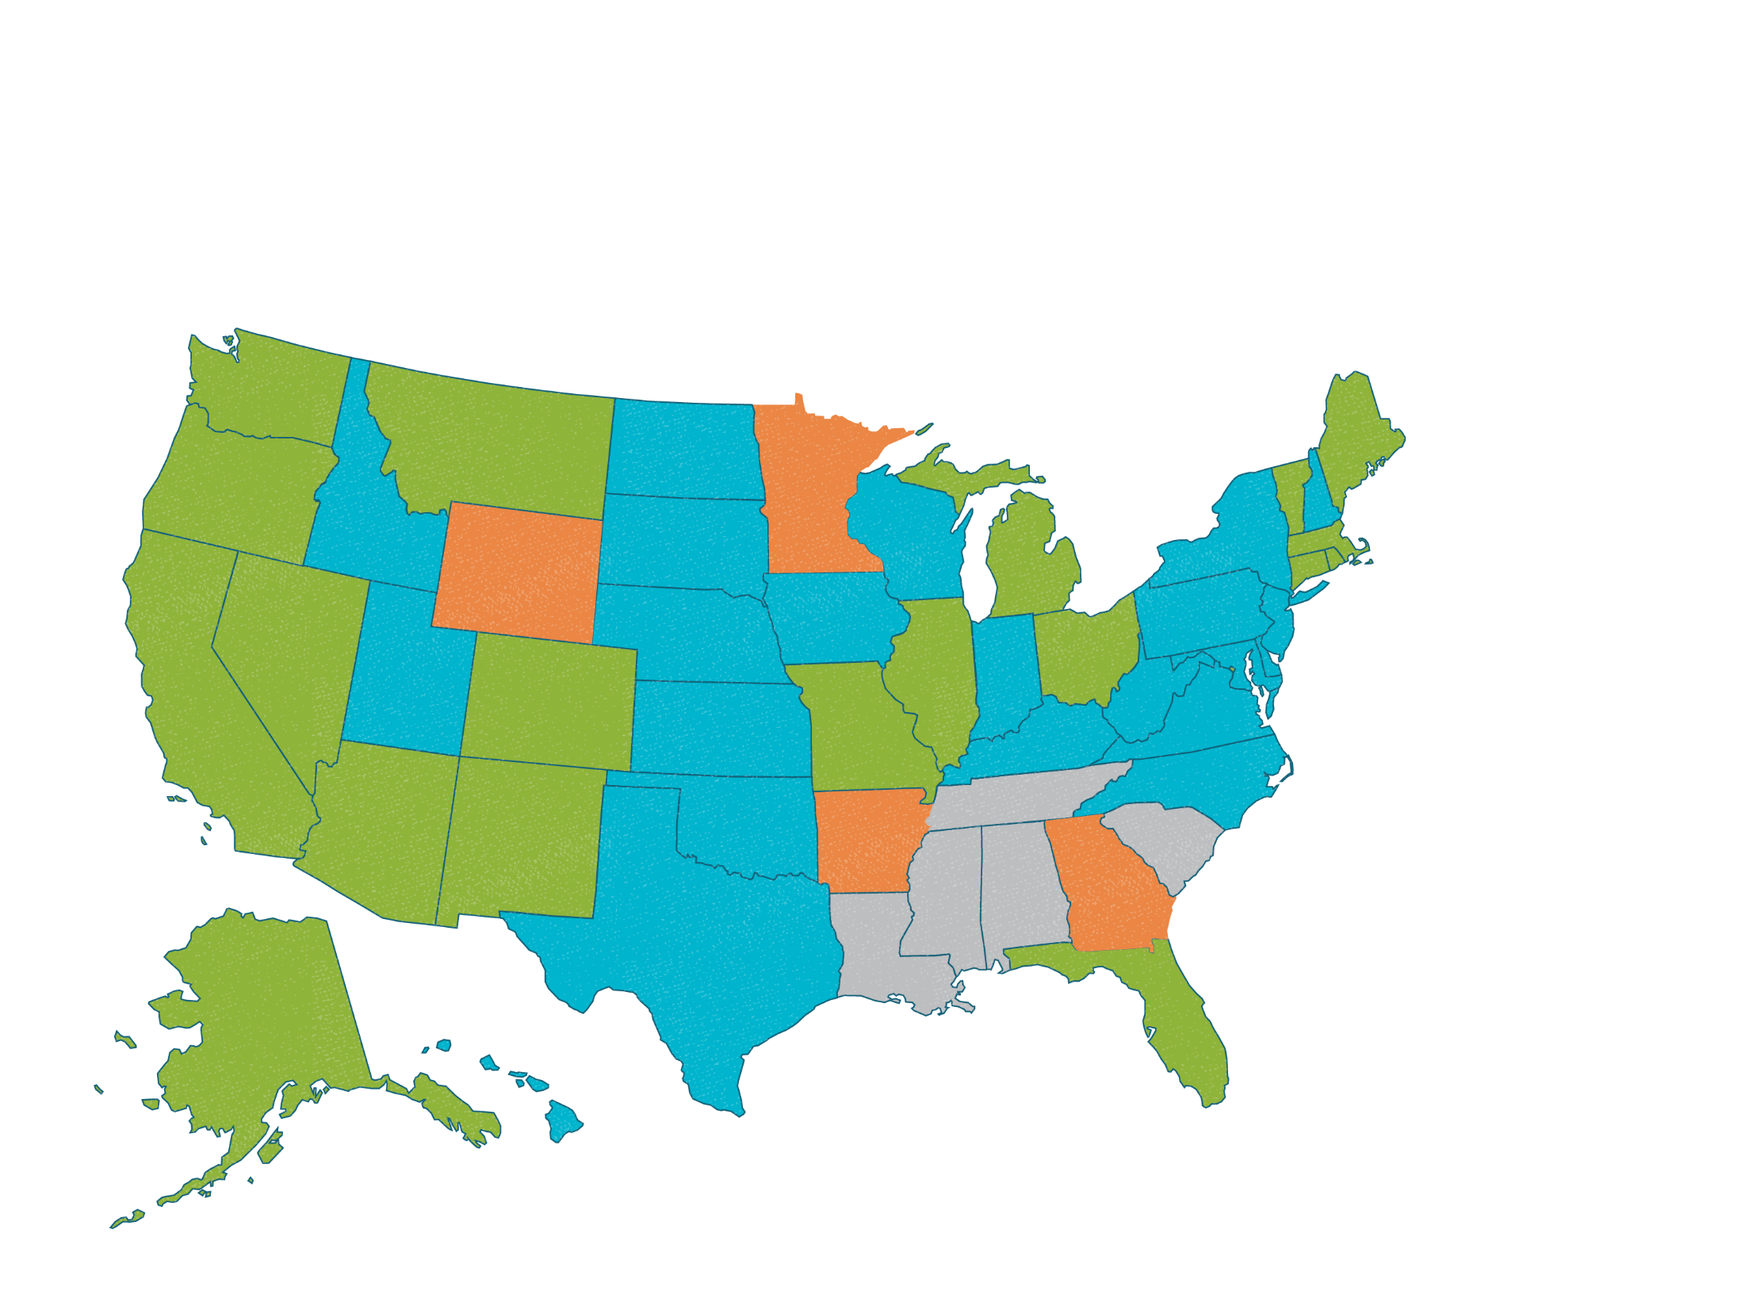

Minimum Wage: Always the Same?
SNAPSHOT
Washington's minimum wage of $9.19/hour is significantly higher than the federal rate and takes precedence over the federal rate in that state.
FEDERAL MINIMUM WAGE
$7.25
WASHINGTON
$9.19
Georgia has a minimum wage of $5.15/hour on the books, but employers must pay their workers the higher federal rate.
GEORGIA
$5.15
Higher than federal rate
Equal to federal rate
Lower than federal rate
No minimum wage
Notes:
A minimum wage is a price floor, a price control that doesn't allow prices—in this case the cost of labor—to fall below an assigned value. Although the media and politicians often discuss the minimum wage in America as if there is only one minimum wage, it turns out that there are numerous minimum wages in the USA. In states where the state minimum wage is not the same as the federal minimum wage, the higher of the two wage rates takes effect.
REVIEW QUESTIONS
Suppose you live in Arkansas and are looking for a job. The state minimum wage rate is $6.25/hour, the federal minimum wage rate is $7.25/hour, and the market equilibrium wage for the job is $8.00/hour. What wage will you be paid? Are the state and national minimum wages binding or non-binding price floors?
Suppose Wisconsin increases its minimum wage from $7.25/hour, which is below the market wage for low-skill labor, to $11.00/hour, which is above the market wage. Using supply and demand curves, show how this might affect the number of employed workers.

Slide 25
Politics and Minimum Wage
Politically
Raising a non-binding wage floor will seem caring and benevolent.
Economically
Raising a non-binding wage floor will have no effect, as long as the new floor is still below the equilibrium wage.
Locally
States with the highest (binding) minimum wages also have some of the highest unemployment.
Washington, Oregon, California

Slide 26
Remembering Price Controls
P
S
Binding price floor
P*
Equilibrium
Binding price ceiling
D
Q
Q*
Notes:
Click through to show the price controls.
It's sort of difficult at first when we see that the binding floor is HIGH and the ceiling is LOW, since we often think of the ceiling being above us and floor being below us.

Slide 27
Summary
A price ceiling is a legally imposed maximum price.
The resulting shortage is problematic.
Prices no longer signal relative scarcity.
Two unintended consequences: a smaller supply of the good (Q_{s}) and a higher price for those who turn to the black market.
A price floor is a legally imposed minimum price.
The minimum wage is an example of a price floor.
Notes:
Price ceiling:
Under rent control, one example of a price ceiling, the prices of apartments are capped by the local government to keep housing more affordable. Since rent control prevents sellers from increasing their price, the quantity demanded will exceed the quantity supplied. The resulting shortage is problematic. Prices no longer signal relative scarcity. The price ceiling has created two unintended consequences: a smaller supply of the good (Q_{s}) and a higher price for those who turn to the black market.
Price floor:
The minimum wage is an example of a price floor. If the minimum wage is set above the equilibrium wage, a surplus of the labor will develop. As a result, proponents of the minimum wage are concerned about finding ways to alleviate the resulting surplus of labor, or unemployment.

Slide 28
Summary
Price controls lead to many unintended consequences.
Shortages or surpluses
Black markets
Artificial attempts to bring the market back into balance

Slide 29
Practice What You Know
What will be the effect of a non-binding price ceiling?
A surplus will be created.
A shortage will be created.
There will be no effect.
The effect is unknown.
Notes:
Correct answer: C
If the price ceiling is non-binding (above the equilibrium), the equilibrium price is already in the legal range, so nothing will change.

Slide 30
Practice What You Know
In the event of a binding price ceiling, what is one function that a black market serves?
Reduces the shortage caused by the price ceiling
Decreases the price even further
Creates a monopoly
Causes a surplus of the good
Notes:
Correct answer: A
More trading may illegally take place at higher prices with a black market.

Slide 31
Practice What You Know
What is one unintended consequence of rent control?
People in rent-controlled units will relocate more often.
Landlords may not maintain rental units.
Too many apartments will be built, creating a surplus of units.
People will choose not to live in big cities.
Notes:
Correct answer: B
With artificially low prices, the landlords may decide it is not worth the time or effort to keep units clean and fixed. The word "slumlord" comes to mind.

Slide 32
Practice What You Know
Which of the following is true about labor markets?
The minimum wage is a price ceiling.
Unemployment is a labor shortage.
Firms supply the labor.
None of the above.
Notes:
Correct answer: D
The minimum wage is a price floor.
Unemployment is a labor surplus.
Firms demand labor (individuals supply the labor).

Slide 33
Practice What You Know
Supply and demand generally become more elastic in the long run. This means that shortages caused by price ceilings _________ in the long run.
disappear completely
become smaller
become larger
become infinitely large
Notes:
Correct answer: C
Q_{d} and Q_{s} will be more responsive to price changes when demand and supply are more elastic. Thus, shortages are made worse because Q_{d} rises faster and Q_{s} falls faster.

Slide 34
Consumer and Producer Surplus
Welfare economics
The study of how the allocation of resources affects economic well-being
Economic welfare is composed of two measures of market value:
Consumer surplus
Producer surplus
Notes:
Although "welfare" may sometimes have a negative connotation, think of "economic welfare" as a measure of how well off or how efficient the market is. Higher economic welfare means more gains from trade are being realized.

Slide 35
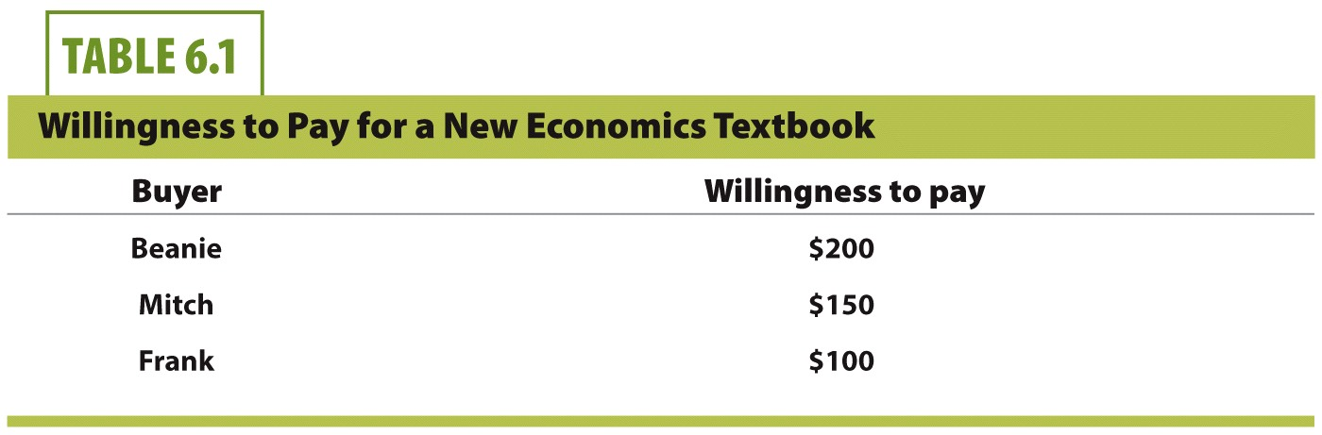
Consumer Surplus
Intuition of willingness to pay?
If the actual price of the textbook is $151, which buyer(s) will purchase the book?
Notes:
Here we have 3 buyers and their willingness to pay for an economics textbook.
Willingness to pay (WTP) is pretty self-explanatory. How much are you willing to pay (at most) for a good or service?
Different people have different demands, so WTP is different for different people. Some people have more money, or may really enjoy the good, so they are willing to pay more. Other people have less money, or don't like the good as much, so their WTP is less.
If the price is $151, only Beanie will buy the book.

Slide 37

Consumer Surplus
Consumer surplus
Difference between willingness to pay for a good and the price actually paid to get the good
At price = $151
Only Beanie buys the book.
He gets $49 worth of consumer surplus.
Why don't Mitch and Frank buy the book?
Notes:
Beanie is WILLING to pay $200 for the book, so having the price be ONLY $151 is a good deal for him. He purchases the book, and spends $49 LESS than what he was WILLING to spend! This difference is called consumer surplus.
Mitch and Frank's WTP is less than the $151 price, so they do not purchase the book. If they did, they would experience negative consumer surplus. Trade is voluntary, and Mitch and Frank do not want to voluntarily engage in trade that makes them worse off.

Slide 38
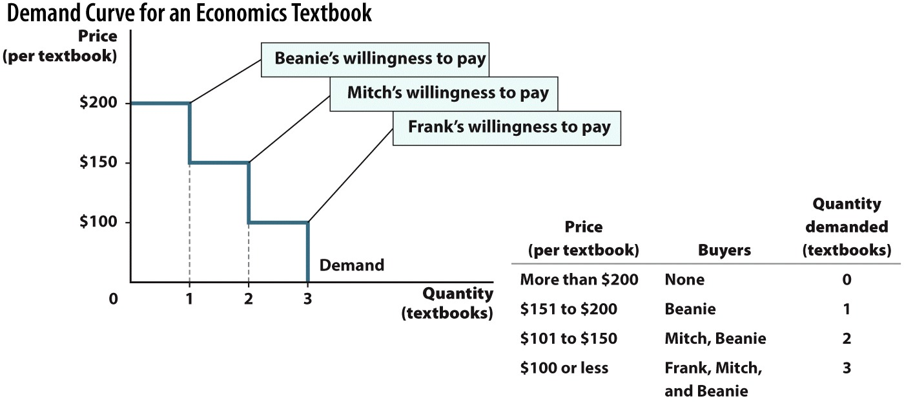

Slide 39
Consumer Surplus, Graphically
Notes:
Great explanation from text:
Where the price is $175, only Beanie decides to buy. Since his willingness to pay is $200, he is better off by $25; this is his consumer surplus. The green-shaded square under the demand curve and above the price represents the benefit Beanie receives from purchasing a textbook at a price of $175.

Slide 40
Consumer Surplus, Graphically
Notes:
Great explanation from text:
When the price is lowered to $125, Mitch also decides to buy a textbook. The total quantity demanded is now 2 textbooks. Mitch's willingness to pay is $150, so his consumer surplus, represented by the pink-shaded square, is $25. However, since Beanie's willingness to pay is $200, his consumer surplus rises from $25 to $75. So a textbook price of $125 raises the total consumer surplus to $100.
In other words, lower prices create more consumer surplus in the market.

Slide 41

Producer Surplus
Seller | Willingness to sell tutoring services
Beanie | $30 / hour
Mitch | $20 / hour
Frank | $10 / hour
Willingness to sell determined by:
Direct costs.
Opportunity costs.
Question:
If the market price of tutoring is $25, which sellers will choose to tutor?
Notes:
Here we have three sellers and their willingness to sell their tutoring services.
Willingness to sell is analogous to the consumer's WTP. In this case, though, we ask what is the LEAST amount the producer would accept for his goods or services?
More on willingness to sell:
The cost of producing an item is NOT the only cost to consider in making the decision of whether or not to produce it. Producers also have opportunity costs. Beanie, Mitch, and Frank each have a unique willingness to sell because they have different opportunity costs.
Beanie owns his own business, so for him, time spent tutoring is time that he could have been making money elsewhere.
Mitch is a business student who might otherwise be studying to get better grades.
Frank is neither a businessman nor a serious student, so the $10 he can earn in an hour of tutoring is not taking the place of earning an even better rate working at his own business or getting better grades from studying more.
So at the price of $25 then . . .
Mitch and Frank will tutor. We will see their producer surplus (PS) next.

Slide 42
Producer Surplus
Seller | Willingness to sell tutoring services
Beanie | $30 / hour
Mitch | $20 / hour
Frank | $10 / hour
Producer surplus
Difference between willingness to sell a good and the price actually received for that good
At price = $25
Mitch and Frank decide to tutor.
Frank gets $15 worth of producer surplus per hour.
Mitch gets $5 worth of producer surplus per hour.
Why doesn't Beanie tutor?
Notes:
Beanie doesn't tutor because he would only be willing to tutor if he received at least $30 per hour. $25 per hour is not enough of an incentive for him to tutor.

Slide 43
Using Supply to Illustrate Producer Surplus
Notes:
The supply curve has an upward step for each additional tutor that supplies his services in the market.
From the text:
At any price less than $10, no one wants to tutor. At prices between $10 and $19 an hour, Frank is the only tutor, so the quantity supplied is 1. Between $20 and $29 an hour, Frank and Mitch are willing to tutor, so the quantity supplied rises to 2. Finally, if the price is $30 or more, all three friends are willing to tutor, so the quantity supplied is 3. As the price they receive for tutoring rises, the quantity supplied increases.

Slide 44
Producer Surplus: Graphically
Notes:
The price of an hour of tutoring is $15. At that price, only Frank decides to tutor. Since Frank would be willing to tutor even if the price were as low as $10/hr., Frank is $5 better off tutoring.
Frank's producer surplus is represented by the pink-shaded area between the supply curve and the price of $15. Since Beanie and Frank do not tutor when the price is $15, they do not receive any producer surplus.

Slide 45
Producer Surplus: Graphically
Notes:
The price for tutoring is $25/hr. At this price, Mitch also decides to tutor. Mitch's willingness to tutor is $20 so when the price is $25/hr., his producer surplus is $5, represented by the blue-shaded area.
Since Frank's willingness to tutor is $10, at $25/hr. his producer surplus has risen to $15.
By looking at the shaded boxes on the right, we see that an increase in the rates for tutoring raises the combined producer surplus.

Slide 46
Economics in Bourne Identity
"Bourne Identity"
How much money would you want for driving a stranger to Paris?
Notes:
"Economics in the Media" Slide
Lecture tip:
The clip mentioned on the slide can be found in the Interactive Instructor's Guide. Access the direct link by clicking the icon in the PowerPoint above.
The key concepts covered in this clip are:
Consumer and producer surplus
Gains from trade
Elasticity
Bourne is desperate to find a ride to Paris, so he offers $10,000 to a stranger for a lift.
She needs the money, but is reluctant to take him up on it.
Why would someone offer that much money unless there is something wrong?
She agrees to help him after he offers to pay her an additional $10,000.
After showing students this clip, you can ask them the following questions:
How would you evaluate their consumer and producer surplus, and the gains from trade?
Is Bourne's demand elastic or inelastic?

Slide 47
Economics in Just Go With It
"Just Go With It"
This clip illustrates willingness to buy, willingness to sell, consumer surplus, and producer surplus.
Notes:
"Economics in the Media" Slide
Lecture tip:
The clip mentioned on the slide can be found in the Interactive Instructor's Guide. Access the direct link by clicking the icon in the PowerPoint above.
The key concepts covered in this clip are:
Consumer and producer surplus
Gains from trade
Supply and demand
Adam Sandler negotiates with a young girl to convince her to pretend to be his daughter.
They settle on $300, and a three-week acting camp.
He would've paid $500, whereas she would've done it for the experience.
After showing students this clip, you can ask them the following questions:
How much was Sandler's consumer surplus?
WTP = $500, but P = $300, so $200.
How much was the girl's producer surplus?
P = $300, WTS = $0, so $300.

Slide 48
Consumer and Producer Surplus
Consumer surplus graphically:
The height of the demand curve is our maximum willingness to pay for that unit of the good.
Consumer surplus is the area below the demand curve and above the price, for all units purchased.
Important concept:
You can only get consumer surplus on units that you actually buy!
CS is NOT the entire area under the demand curve.

Slide 49
Consumer and Producer Surplus
Producer surplus graphically:
The height of the supply curve is the firm's lowest price it is willing to accept to sell that unit of the good.
Producer surplus is the area above the supply curve and below the price, for all units sold.
Important concept:
The firm can only get producer surplus on units that it actually sells!
PS is NOT the entire area above the supply curve.

Slide 50
Market Efficiency
Total surplus (or social welfare) measures the overall welfare of the society.
Total surplus = CS + PS
In free markets with voluntary trade:
Consumers buy until their willingness to pay is equal to the market price.
Suppliers sell until their willingness to sell is equal to the market price.
Efficiency
Occurs when total surplus is maximized in a market.
Notes:
Once again, you may want to point out that even though "welfare" often has a negative connotation, "economic welfare" is a sign of how well off or how efficient our economy is at capturing gains from trade. An increase in economic welfare is a good thing.
In a free and competitive market, the market price will be the equilibrium price.

Slide 51

CS and PS for a Gallon of Milk
Notes:
You can only get CS on units that you as a consumer actually purchase.
A producer can only get PS on units that he actually sells.
Graph notes
Consumer surplus:
Alice is willing to pay $7 for milk, but the price is $4. The difference between the price she is willing to pay, represented by point A, and the price she actually pays, represented by E, is $3 in consumer surplus.
Betty is willing to pay $5 for milk, but the price is $4. Therefore, she receives $1 in consumer surplus, indicated by the blue arrow that shows the distance from $4 to $5.
In fact, all consumers who are willing to pay more than $4 are better off when they purchase the milk at $4. We can show this total area of consumer surplus on the graph as the blue-shaded triangle bordered by the demand curve, the y-axis, and the equilibrium price. At every point in this area, consumers who are willing to pay more than the equilibrium price for milk will be better off.
Producer surplus:
The Contented Cow is willing to sell milk for $2.50 a gallon, represented by point C. Since the equilibrium price is $4.00, the business makes $1.50 in producer surplus. This is indicated by the red arrow that shows the distance from $4.00 to $2.50.
If we think of the supply curve as representing the costs of many different sellers, we can calculate the total producer surplus as the red shaded triangle bordered by the supply curve, the y-axis, and the equilibrium price.
Overall welfare:
The shaded-blue triangle (consumer surplus) and the shaded-red triangle (producer surplus) describe the increase in total surplus, or social welfare, created by the production and exchange of the good at the equilibrium price.
At the equilibrium quantity of 6 million gallons of milk, output and consumption reach the largest possible combination of producer and consumer surplus. In the region of the graph beyond 6 million units, buyers and sellers would experience a loss.
When an allocation of resources maximizes total surplus, the result is said to be efficient. Efficiency occurs at point E when the market is in equilibrium. At any other non-equilibrium price, less trading will occur, and less surplus will be gained.

Slide 52


Taxation, Welfare, and Deadweight Loss
Why do we pay taxes?
Pay for public goods, police, roads, schools, etc.
Types of taxes
Income, payroll, corporate, sales, excise, estate
Excise tax
A tax on a specific good; alcohol, tobacco, gasoline, for example
Tax incidence
Refers to the party (consumers or producers) who bears the tax burden.
Notes:
Taxes provide benefits, and exemplify the idea that there is no free lunch.
Taxes pay for many services we use daily for "free," but don't think about.
Excise taxes on alcohol and tobacco are sometimes called sin taxes. Consumption of these goods can sometimes have negative externalities, so a tax may reduce consumption and help correct the externality.
Excise taxes, such as cigarette, alcohol, and gasoline taxes, account for less than 4% of all tax revenues. But because we can isolate changes in taxes on one item at a time, they provide a good way for us to understand the overall effect of a tax.
With regard to tax incidence, we'll see that sometimes consumers pay most of the tax burden. Other times, producers pay most of the tax.

Slide 53
Tax on Buyers
Notes:
Consider a $1 tax placed on milk purchases. Each time a consumer buys a gallon of milk, the cash register adds $1 in tax. Because of the tax, the price of milk goes up and the demand curve shifts down. Why does the demand curve shift? Consumers know that they must pay the purchase price and also the tax. The extra cost makes them less likely to buy milk at every price, which causes the entire demand curve to shift down.
The intersection of the new demand curve with the existing supply curve creates a new equilibrium price of $3.50—$0.50 lower than the original equilibrium price of $4.00. But even though the price is lower, consumers are still worse off. Since they must also pay the $1.00 tax, the total price rises to $4.50 per gallon. Therefore, despite the rise in price, the seller nets only $3.50.
A similar logic applies to the consumer. Since the new equilibrium price after the tax is $0.50 higher, the consumer shares the $1.00/gallon tax incidence equally with the seller.
End result: The consumer pays $0.50 more and the seller nets $0.50 less.
The tax also affects the amount sold in the market. Since the new equilibrium price after the tax is higher, consumers of milk reduce the quantity demanded from 1000 gallons to 750 gallons. As a result, the market for milk is smaller than it was before the tax was placed on the good.
Actual tax revenue collected by government:
Tax revenue = (tax amount) × (number of units taxed)
Tax revenue = $1.00 × 750
Tax revenue = $750

Slide 54
Tax on Sellers
Notes:
What happens when a tax of $1/gallon is placed on milk suppliers
First, look at the shift in the supply curve. Why does it shift? The $1/gallon tax on milk lowers the profits that dairy farmers expect to make, which causes them to produce less milk at every price level.
We can also think of the entire supply curve as shifting up in response to the tax that milk producers must pay to the government.
The intersection of the new supply curve with the existing demand curve creates a new equilibrium price of $4.50—$0.50 higher than the original equilibrium price of $4.00. This occurs because the seller is able to pass some of the tax increase along to the buyer in the form of a higher price. However, the seller is still worse off. After the tax, the new equilibrium price is $4.50, but $1.00 must be paid as tax to the government.
End result: The producer receives $0.50 less and the buyer pays $0.50 more. This is the same end result as the previous graph when the tax was paid by the producers!
The tax on milk purchases also affects the amount sold in the market. Since the after-tax equilibrium price is lower, producers of milk reduce the quantity that they sell to 750 gallons. Therefore, the market for milk is smaller than it was before the tax was placed on the good.
Actual tax revenue collected by government:
Tax revenue = (tax amount) × (number of units taxed)
Tax revenue = $1.00 × 750
Tax revenue = $750

Slide 55
End Result
If a tax is levied on a business:
The firm will attempt to raise prices to pass some of the burden to consumers.
If a tax is levied on consumers:
Some of the burden is passed to producers since the market price falls.
Incidence
Whether the tax is levied on the producer or consumer, the end incidence result is the same!

Slide 56
Deadweight Loss
On the previous graphs, the tax had a price and quantity effect.
Prices increased.
Quantity traded decreased.
Deadweight loss:
A cost to society in the form of less economic welfare resulting from the tax.
Caused by the decrease in the amount of trade that is occurring.
Notes:
Recall that even though prices went up, the producer still is worse off since it had to pay part of the tax.
DWL is the result of the decreased number of transactions. When the price is anything but the equilibrium price (such as with a tax or price control), the number of trades will decrease.
Think of DWL as the following:
Graphically, DWL is an area that COULD HAVE been somebody's surplus (producer and/or consumer) at a different price and quantity, but at the current situation, belongs to nobody.
Tax revenue collected by the government is NOT DWL! The taxes belong to the government. DWL belongs to nobody; recall that you can only get surplus on units that are actually traded! We aren't trading those units anymore!

Slide 57
Deadweight Loss, Graphically
Notes:
The graph is the same as before, but the only difference is the added yellow triangle, which represents DWL.
Area of a triangle = ½ × (base of triangle) × (height of triangle)
DWL in this case is $125.
The amount purchased to decline from 1000 to 750 gallons, a reduction of 250 gallons sold in the market. The yellow triangle represents the deadweight loss caused by the tax. The rise in price causes the loss of some consumers, who would have paid between $4.00 and $4.50. Likewise, the reduction in the price the seller receives means that producers who once sold a gallon of milk between $3.50 and $4.00 will no longer be willing to do so.
The combined reductions in consumer and producer surplus equal the deadweight loss produced by a $1 tax on milk.

Slide 58
Tax and Deadweight Loss with Inelastic Demand
Tax incidence is the same no matter who the tax is levied on.
Elasticity of demand and supply can change tax incidence, though.
Why would the government want to tax a good with very inelastic demand?
No substitutes (ensures steady tax revenue)
Amount of purchases will not change much (or not change at all if perfectly inelastic demand).
This means little or no deadweight loss!
Notes:
Generally, we'll see that the more inelastic (insensitive) market participant pays most of the tax. If consumers are inelastic, the producers will be able to pass the entire tax onto the consumers in the form of a price increase.
With regard to a perfectly inelastic demand, a tax will create zero deadweight loss. This means market efficiency doesn't change as a result of the tax.
Picture: Cigarettes have a very inelastic demand!

Slide 59
Tax and Deadweight Loss with Perfectly Inelastic Demand
Notes:
The left graph shows the market before the tax. The blue rectangle represents consumer surplus and the red triangle represents the producer surplus.
The right graph shows a tax is levied on the seller. The supply curve shifts from S_{b} to S_{a}. The shift in supply causes the equilibrium to move from E_{b} to E_{a} and the price to rise from P_{b} to P_{a}. We know that when demand is perfectly inelastic, a price increase does not alter how much consumers purchase. Thus, the quantity demanded remains constant at Q even after the government collects tax revenue equal to the green-shaded area.
On the right graph, there is no DWL area! This means that the total surplus, or social welfare, is equal in both graphs.
On the right, the green area is subtracted entirely from the blue rectangle, which indicates that the surplus is redistributed from consumers to the government. But overall, society enjoys the same total surplus. From this we see that when demand is perfectly inelastic, the incidence, or the burden of taxation, is borne entirely by the consumer.

Slide 60
Tax and Deadweight Loss with Somewhat Elastic Demand
Notes:
Assume that demand and supply are "equally" elastic here.
Left graph:
Before the tax, price is equal to the equilibrium price, and the market is efficient with no DWL.
Right graph:
After the tax, the area of price movement (from P_{b} to P_{a}) is smaller than the area on the previous perfectly inelastic figure. In this case, the graph is drawn with elasticities such that the consumers absorb half of the tax. Because demand is sensitive to price, suppliers must absorb the other half of the tax, from P_{b} to P_{c}, themselves, and net P_{c}, which is less than what they received when the good was not taxed.
In addition, the total tax revenue generated (the green-shaded area) is smaller in this figure compared to the previous perfectly inelastic demand, because as the price of the good rises, some consumers no longer buy it and quantity demanded falls from Q_{b} to Q_{a}. (The government is getting less tax revenue because less units are being taxed compared to the previous graph.)
The yellow triangle (DWL) is a further indication of the decreased number of trades. Less transactions causes DWL, and gains from trade are not maximized. After the tax, this market is no longer economically efficient.
You can see that the areas of surplus and tax revenue on the right are not as big as the surplus areas on the left. Once again, DWL belongs to nobody.

Slide 61
Tax and Deadweight Loss with Perfectly Elastic Demand
Notes:
In this graph, demand is perfectly elastic (horizontal demand).
Left graph:
The price is equal to the height of the demand function. There is no consumer surplus, but there is producer surplus due to the upward-sloping supply function. There is no DWL.
Right graph:
In this market, consumers are so price-sensitive that they are unwilling to accept any price increase. Because sellers are unable to raise the equilibrium price, they bear the entire incidence of the tax.
This has two effects. First, producers are less willing to sell the product at all prices. This shifts the supply curve from S_{b} to S_{a}. Since consumer demand is highly elastic, consumers pay the same price as before. Second, they are also worse off because less is produced and sold, in the movement from Q_{b} to Q_{a}. The result is that there is also more deadweight loss.
Therefore, the total surplus, or efficiency of the market, is much smaller than before the tax.
Comparing the green-shaded areas of three figures and you see that the size of the tax revenue is also noticeably smaller in the market with highly elastic demand.
Policy implication:
Tax goods with inelastic demand! This leads to higher tax revenues and less (or no) deadweight loss.

Slide 62
Realistic Example
Notes:
A $3 per pound tax is placed on mushroom suppliers.
This drives the equilibrium price up from E1 ($7) to E2 ($8).
Notice that the price only rises by $1. This means that the consumer picks up $1 of the $3 tax and the seller must pay the remaining $2.
Therefore, most of the incidence is borne by the seller.
Finally, neither the demand curve nor the supply curve is relatively inelastic, so the amount of deadweight loss (DWL) is large.

Slide 63
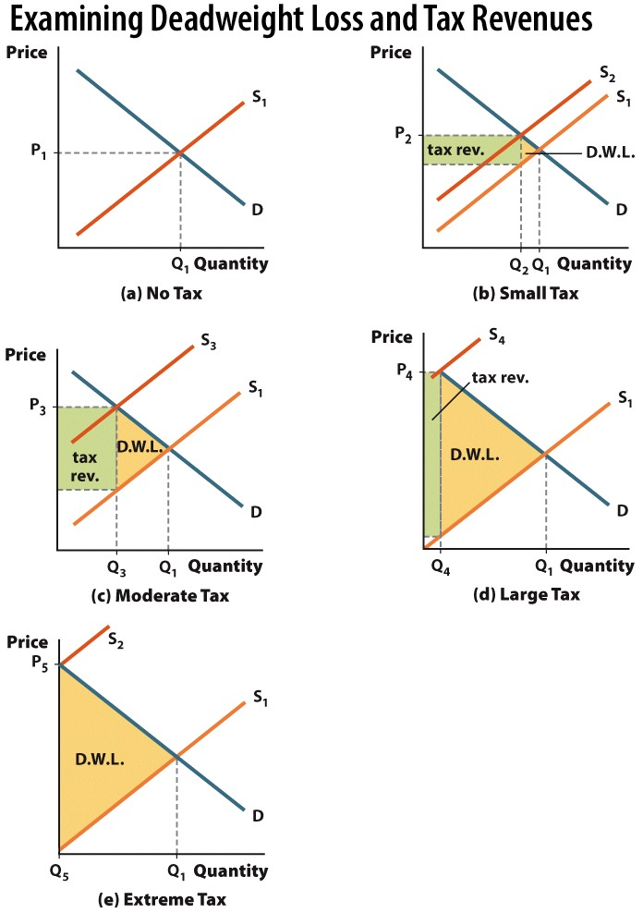

Slide 64
Excise Tax Summary
A tax on a good with inelastic demand or supply generates the maximum amount of revenue.
The deadweight loss of a tax is larger when demand and supply are more elastic.
The incidence of a tax is determined by the relative balance between the elasticity of supply and the elasticity of demand.
Notes:
Policy implication derived from points 2 and 3:
If you want to place an excise tax on a good, place the tax on a good with a very inelastic demand or supply! This will decrease DWL and increase tax revenues.
This is true if we assume the purpose of the tax is to raise revenue without hurting market efficiency. If we tax a good because we want less of that good produced or consumed, such a tax will only be successful if the good is elastic in demand or supply.

Slide 65
Conclusion
Consumer and producer surplus can be used to examine any economic activity.
Unregulated markets create the largest possible total surplus.
Taxation is not a costless endeavor. The taxation of specific goods and services gives rise to deadweight loss, which results in the reduction of economic activity.

Slide 66
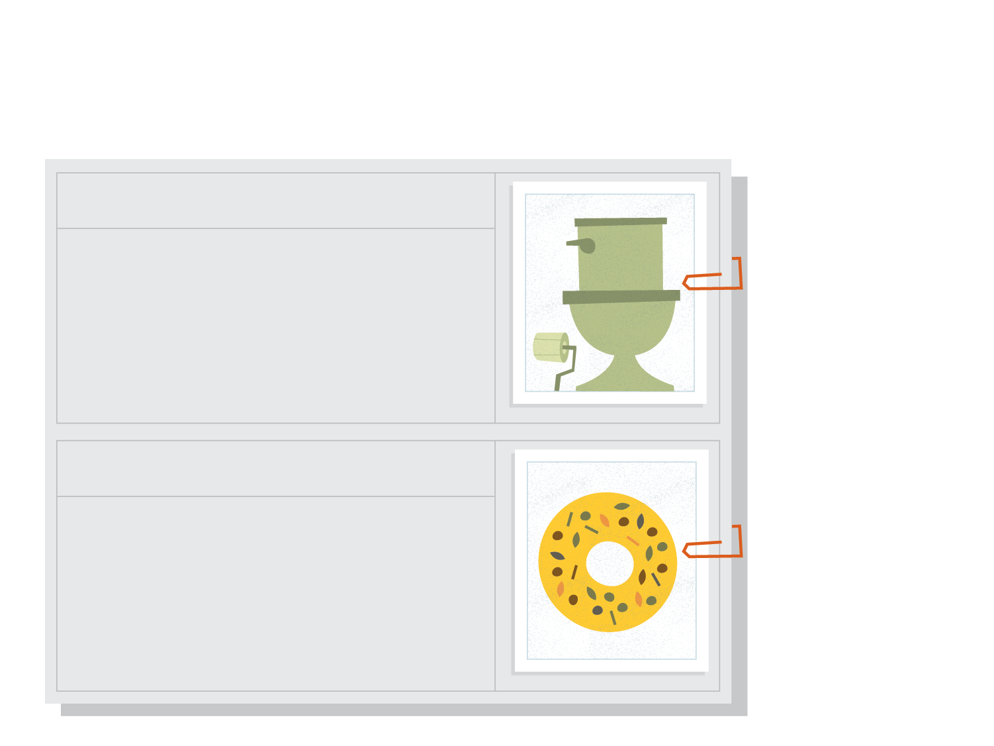

Bizarre Taxes
SNAPSHOT
Flush Tax
Marylanders are being taxed on a negative externality, which we'll cover in the next chapter.
Maryland's "Flush Tax," a fee added to sewer bills, went up from $2.50 to $5.00 a month in 2012. The tax is paid only by residents who live in the Chesapeake Bay Watershed, and it generates revenue for reducing pollution in Chesapeake Bay.
Bagel Tax
New Yorkers love their bagels and cream cheese from delis. In the state, any bagel that has been sliced or has any form of spread on it (like cream cheese) is subject to a 9% sales tax on prepared food. Any bagel that is purchased "unaltered" is classified as unprepared and is not taxed.
Notes:
Governments tax their citizens for a variety of reasons. Often it's to raise revenue. Sometimes, taxes are levied to influence citizens' behavior. Occasionally, both of these reasons are in play. These two motivations have led to some very bizarre tax initiatives, as seen below. Though they all seem a bit unusual, these taxes get (or got) paid every single day.
REVIEW QUESTIONS
Suppose that because of Alabama's playing card tax, fewer consumers purchase cards and fewer store owners sell them. What is this loss of economic activity called?
Do you think the New York bagel tax is an effective tool to raise government revenue? Think about how the tax may or may not affect the purchasing behavior of New Yorkers.

Slide 67
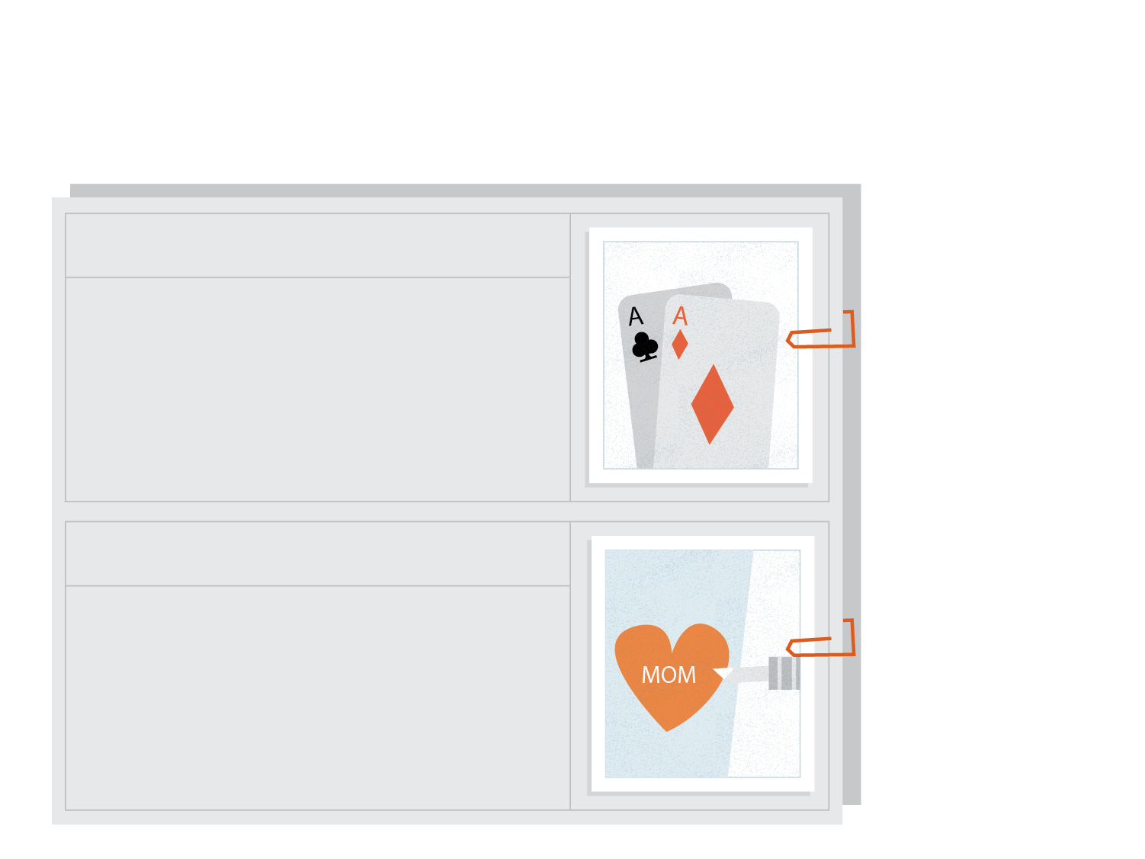
Bizarre Taxes
SNAPSHOT
Playing Card Tax
The state of Alabama really doesn't want you playing solitaire. Buyers of playing cards are taxed ten cents per deck, while sellers must pay a $2 annual licensing fee. How much revenue does just a ten-cent tax generate? In 2011, it was almost $90,000.
Tattoo Tax
Arkansas imposes a 6% tax on tattoos and body piercings to discourage this behavior, meaning that the people of Arkansas pay extra when getting inked or pierced.
Notes:
Governments tax their citizens for a variety of reasons. Often it's to raise revenue. Sometimes, taxes are levied to influence citizens' behavior. Occasionally, both of these reasons are in play. These two motivations have led to some very bizarre tax initiatives, as seen below. Though they all seem a bit unusual, these taxes get (or got) paid every single day.
REVIEW QUESTIONS
Suppose that because of Alabama's playing card tax, fewer consumers purchase cards and fewer store owners sell them. What is this loss of economic activity called?
Do you think the New York bagel tax is an effective tool to raise government revenue? Think about how the tax may or may not affect the purchasing behavior of New Yorkers.

Slide 68

Bizarre Taxes
SNAPSHOT
Window Tax
England passed a tax in 1696 targeting wealthy citizens—the more windows in one's house, the higher the tax. Many homeowners simply bricked over their windows. But they could not seal all of them, and the government did indeed collect revenue.
Blueberry Tax
Maine levies a penny-and-a-half tax per pound on anyone growing, handling, processing, selling, or purchasing the state's delicious wild blueberries. The tax is an effort to make sure that the blueberries are not overharvested.
Maine produces 99% of the wild blueberries consumed in the USA, meaning that blueberry lovers have few substitutes available to avoid paying the tax and that demand is therefore inelastic.
Notes:
Governments tax their citizens for a variety of reasons. Often it's to raise revenue. Sometimes, taxes are levied to influence citizens' behavior. Occasionally, both of these reasons are in play. These two motivations have led to some very bizarre tax initiatives, as seen below. Though they all seem a bit unusual, these taxes get (or got) paid every single day.
REVIEW QUESTIONS
Suppose that because of Alabama's playing card tax, fewer consumers purchase cards and fewer store owners sell them. What is this loss of economic activity called?
Do you think the New York bagel tax is an effective tool to raise government revenue? Think about how the tax may or may not affect the purchasing behavior of New Yorkers.

Slide 69
Practice What You Know
The height of the demand curve at any quantity can be thought of as the ___________.
willingness to buy
willingness to sell
consumer surplus
producer surplus
Notes:
Correct answer: A
Willingness to buy (or willingness to pay) is the height of the demand curve.
CS = (height of demand) – (price actually paid)

Slide 70
Practice What You Know
The difference between the price the good was sold at and the minimum price the firm would have accepted for the good is called
willingness to sell.
product markup.
producer surplus.
price-cost margin.
Notes:
Correct answer: C

Slide 71
Practice What You Know
Deadweight loss can be thought of as surplus that is transferred from producers or consumers and given to __________.
the government
competitors in other markets
taxpayers
nobody
Notes:
Correct answer: D
Deadweight loss belongs to nobody, because it arises when we trade less units. You can only get surplus on units you trade!

Slide 72
Practice What You Know
If the government wants to create tax revenues without generating any deadweight loss, what type of good should they tax?
a good with a perfectly elastic demand
a good with a relatively elastic demand
a good with a perfectly inelastic demand
a good with a relatively inelastic demand
Notes:
Correct answer: C
Perfectly inelastic means the demand curve is vertical. A tax will not reduce the quantity purchased at all. CS will decrease as some of it goes to the government for taxes, but no DWL is created.

Slide 73
Sources
"Principles of Economics with Smartwork Access (ISBN: 978-0-26314-5), 1st Edition, 2013" by Mateer and Coppock
"Economics: Custom Edition for NCSU (ISBN: 9781937435202" by David Hyman

